Slide 1
Humanities
Early Childhood Conference
Notes:
Welcome & Thank you for coming.
Personal Introduction (Very Short)
Name
Position
Schools Share my time
Dr. Christmas

Slide 2
Aristotle
“ The aim of art is to represent not the outward appearance of things, but their inward significance.”

Slide 3
TREASURES:
The Things We Keep
Notes:
Introduction – Webster, Florida
Large open air flea market where vendors filled about twenty acres. The treasures found at the market embodied the memories and times of the people who once owned them. Faded works of art, well worn books…
People keep the things that are valuable. It’s part of their humanity.
Many items with prices marked 10 to 20 times higher.

Slide 4
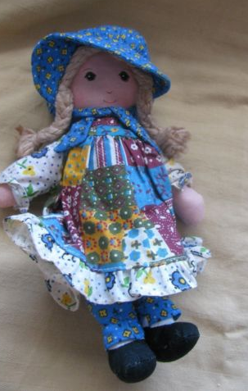
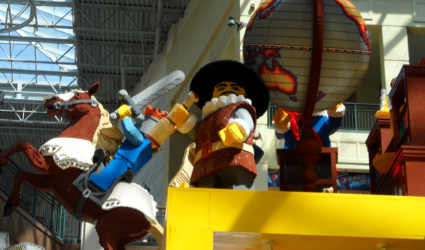
With Time Value Changes
Dickey, Sara. sam_2148.jpg. May 21, 2012. Pics4Learning. 23 Mar 2014 <http://pics.tech4learning.com>
Notes:
The things we value the most are the things we want to keep or recapture. For example, a Strawberry Shortcake doll originally sold for less than $4. Vintage dolls were for sale for $20. Boxes of Lego kits sold for as much or more than when they were first manufactured.
When looking at all the old and worn out items, naturally, the things I could remember from my own past piqued my attention.
We take care of the things we want to keep so we can pass them on to our children.

Slide 5
Treasures Revealed
Cultures past, present and a glimpse of the future
Diversity and similarity
Enriched appreciation of the the present
Focus on Future
(Van Tassel-Baska, 2003)
http://pics.tech4learning.com and personal photographs (composite)
Notes:
Today’s focus on Humanities tells a story of sorts.
Story of the Past – Understanding of the Present – Vision for the Future
Tiger, tiger
Cowboys
Some of my most treasured belongings tell my family’s story
Every culture has a history
Gifts left to our children
Across the globe

Slide 6
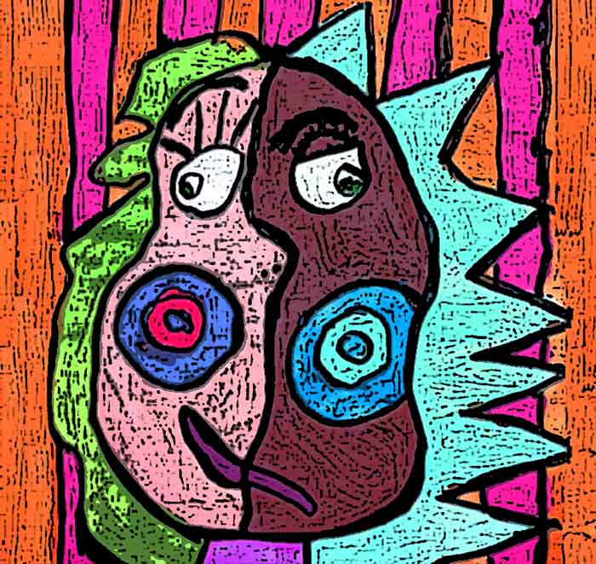
Defining Humanities
Historical Evidence
Glimpse of History
Multidisciplinary
Context for Reading
Social Studies
Foundations for Math
Science
(President’s Committee on the Arts and the Humanities, 2011 & Smutny, Von Fremd, 2005)
Notes:
Defining the Humanities - studies intended to provide general knowledge and intellectual skills (Online free dictionary) Humanities encompasses all the disciplines that relate to being human.
Historical evidence
Arts used to decorate surroundings
Pass along customs and beliefs
Gives children a lifelike glimpse of history
Develop an understanding of multiple disciplines (Smutny, Von Fremd, 2005)
Context for reading – realistic and interesting
Foundations for Math – problem solving skills (President’s Committee on the Arts and the Humanities, 2011)

Slide 7
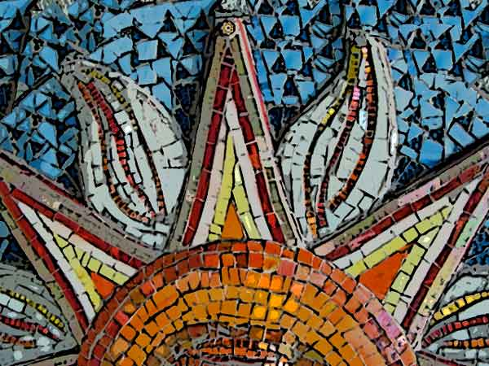
Humanities Programs
Positive Outcomes
Lack of Funding
Programs Available
National Endowment of the Arts
Art Museums
Dothan Area – Wiregrass Museum of Art
Enterprise Area – All About Art
Montgomery Area - Abrakadoodle
(President’s Committee on the Arts and the Humanities, 2011)
Notes:
Positive Outcomes gained through the humanities – benefits well documented Students perform better on standardize assessments when arts and humanities are included
Lack of Funding for humanities in public schools
Programs available in large cities (President’s Committee on the Arts and the Humanities, 2011)
Many smaller areas have made strides to offer programs
The National Endowment of the Arts support and grants – grants for individuals, teachers, and business to build humanities programs
Boston – grant for children to take music lessons $30,000
St. Louis – grant for children to take dance lessons $30,000
St. Petersburg – grant for critically ill children to take art lessons $20,000
Washington D.C. – free music lessons to pre K and elementary children $10,000
Atlanta – modern dance $15,000
Kalamazoo – musical performances for children $13,500
Miami – Arts and crafts $20,000
Art Museums – resources for educators – Almost every museum offers resources for parents and teachers to infuse humanities into the lives of children

Slide 8
President’s Committee Arts and Humanities
Build collaboration – Local artists
Integrate art
More artists teaching in schools
Employ Arts & Humanities to increase rigor
Use systematic data to show impact
“Turn Around” Schools” – 2012
Report published in 2013 shows positive results
(President’s Committee on the Arts and the Humanities, 2011)
Notes:
Members of the President’s Committee on the Arts and the Humanities (2011) – five recommendations to schools

Slide 9
Humanities & Common Core
High Stakes Testing
Humanities Essential
Integration in the core subjects
Facilitate Creative and Analytical Thinking
Preparation for Learning
(De Backer, Lombaerts, DeMette, Buffel, & Elias, 2012 & Smutny, Von Fremd, 2005)
Notes:
Initial results – engaged and interested – express deeper satisfaction
Perform better on standardized tests
1st grade examples (story)
Essential for high ability students (10’ keepers)
Torrance – creativity and problem solving – high correlation to future success.
Creative art and humanities – fertile ground

Slide 10
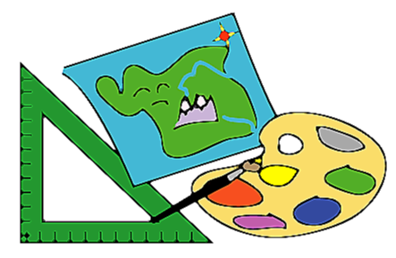
Increase Thinking Skills
Visual, Spatial & Perceptual Thinking Skills
Abiding & Eternal Themes
Understanding the World
Vision for the Future
(Presidential Committee, 2011)
Notes:
Mixing paint with a paintbrush, dancing, singing… NOT JUST ACTIVITIES

Slide 11
Effective Learners and Observers
Brain Development
Inspiration and passion for learning
High Engagement
Memory Exercise
Kolk, Melinda. hagley_harvardmachine.jpg. June 2005. Pics4Learning. 23 Mar 2014 <http://pics.tech4learning.com>
(Melnick, Witmer, & Strickland, 2011)
Notes:
Thanks to medical advancements and imaging machines, we know more about the brain than ever before.
Evidence of how useful the Arts and Humanities to brain development
When humanities are interwoven into the core curriculum students receive inspiration for learning.
Prepare students to grow into effective learners and observers. ABC song
The students become more engaged and interested.
(Melnick, Witmer, & Strickland, 2011)

Slide 12
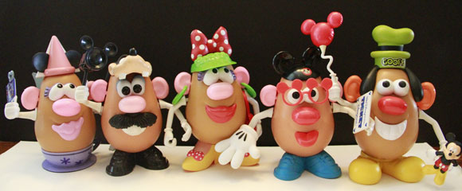
Social and Academic Development
Social
Collaboration
Cooperation
Academic
Transfer of Skills
Link between Disciplines
Photo – Melanie Snow
(Melnick, Witmer, & Strickland, 2011)
Notes:
Promote healthy social and academic development.
Social development
Collaboration
Cooperation
Academic development
Transfer of skills
Understanding between disciplines

Slide 13
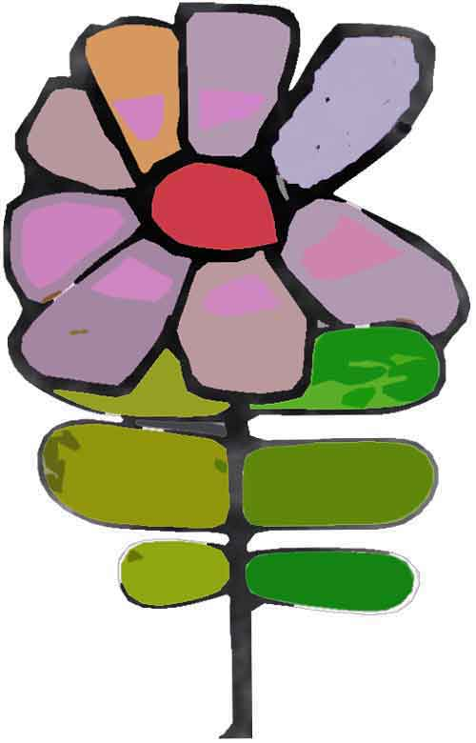
Make an Artifact
Model Magic
Enlarge Awareness
Self
Others
Course of Study Standards:
Create works of art to communicate ideas.
Use words that describe and represent real-life.
Participate in conversations about various topics and texts with peers and adults.
Speak audibly and express thoughts, feelings, and ideas.
Stacy. purpleflower.jpg. 9-26-06. Pics4Learning. 9 Mar 2014 <http://pics.tech4learning.com>
Notes:
Activity – making an artifact using clay (Model Magic) – Activities related to humanities provide children many opportunities to enlarge awareness of themselves, other people, and the world.

Slide 14
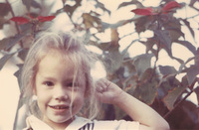
Artifact Example
“My mother grows beautiful flowers in her garden. I like playing in the garden, so I made a flower.”
Notes:
Use the clay to make a simple object that tells something about you or your family.

Slide 15
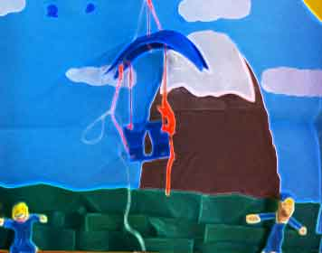
Today’s Focus
Literature
Social Studies
Arts
Notes:
There are many disciplines associated with Humanities
Today’s focus covers three aspects of human culture:
Literature – Jennifer will acquaint us with the timeless themes in literature that help us understand our world and humanity.
Social Studies – Catherine will give us the motivation to look at the Humanities through the scope of human responsibility to protect the environment.
Arts – Johnetta will provide a rationale for infusing the arts into every aspect of the curriculum.

Slide 16
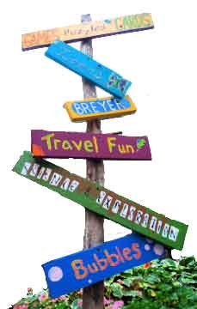
Intangible Gifts in Humanities
Appreciation for Art
Love of Literature
Understanding of their Human Responsibility
More information on websites:
www.margietyner.net
www.marginuity.weebly.com
Photo – Ashley Tindell
Notes:
Conclusion: When we give our students the intangible gifts found in the humanities, they receive treasures that last a lifetime.
An appreciation for art
The love of literature
Understanding of human responsibility

Slide 17
References
De Backer, F., Lombaerts, K., DeMette, T., Buffel, T., Elias, W. (2012). Creativity in artistic education: Introducing artists into primary school. International Journal of Art & Design Education, 31(1), 53-66. doi:10.1111/j.1476-8070.2012.01715.x
Herman, G. (2010). Teaching visual art history and appreciation to young children. Teaching for High Potential: Quality Classroom Practice for High-Ability Students, Fall, 22-23.
Karnes, F. A., & Bean, S. M. (2009). Methods and materials for teaching gifted learners. Waco, TX: Prufrock Press
Kim, K. H. (2011). The creativity crisis: The decrease in creative thinking scores on the Torrance tests of creative thinking. Creativity Research Journal, 23(4), 285-295. DOI: 10.1080/10400419.2011.627805
Melnick, S. A., Witmer, J. T., & Strickland, M. J. (2011). Cognition and student learning through the arts. Arts Education Policy Review, 112(3), 154-162. doi:10.1080/10632913.2011.566100

Slide 18
References
Shade, P., Shade, R. (2011). Curiosita teaching: Integrating creative thinking into your 21st century classroom. Marion, IL: Pieces of Learning.
Smutny, J., Von Fremd, S. Igniting creativity in gifted learners, K-6. Thousand Oaks, CA: Corwin Press.
Stoelinga, S., Joyce, K., Booz, A. Silk, Y. (2013) Turnaround Arts Initiative: 2013 Progress Report. President’s Committee on the Arts and Humanities. Washington, D.C.
Tomlinson, C. (2005). The differentiated classroom. Upper Saddle River, NJ: Pearson Education.
President’s Committee on the Arts and Humanities (2011). Reinvesting in arts education: Winning America’s future through creative schools. Washington, D.C.
VanTassel-Baska, J. (2003). Curriculum planning & instructional design. Denver, CO: Love Publishing Company.

