Slide 2
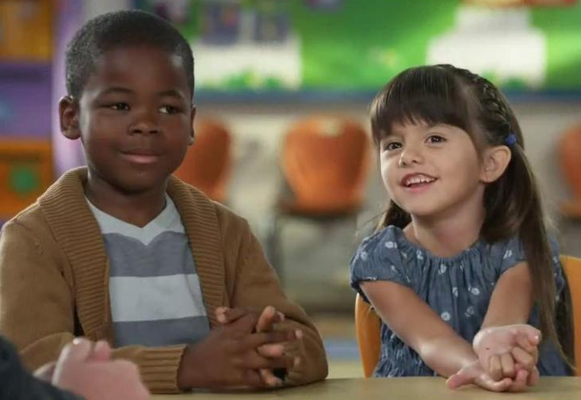
Agenda
Question: What is the funniest or most unusual response you have heard from a student?
Traits of Young Gifted Students
Identification of Gifted Students in Alabama
Ideas for Depth and Complexity
About Enterprise City Schools Gifted Program
Celebration of the Arts

Slide 3
Traits in Young Gifted Children

Slide 4
Exploration and Activity Level

Slide 5
Math and Reading

Slide 6
Asynchronous Development
Over Sensitive to Failure
Emotional Intensities
Different Perspective than peers
Peer Relationships
Poor Social Skills
Awkward with Peers
Lack of Confidence or Very Confident
Notes:
Two big idea:
You don’t need to reboot or start everything new again from scratch.
Whatever you’re doing to successfully manage you classroom, keep doing it.
Your best way to meet the needs of gifted students is to continue engaging them with purposeful instruction.

Slide 7
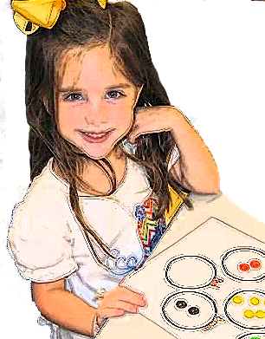
What Is The Difference?
Bright Child | Gifted Learner | Creative Learner
Is attentive | Mentally involved | Daydreams and seems off task

Slide 8
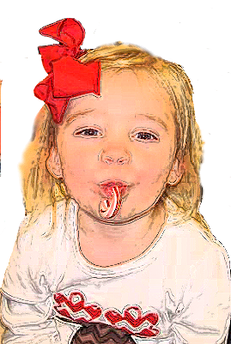
What Is The Difference?
Bright Child | Gifted Learner | Creative Learner
Works Hard | Knows without working hard | Plays around with ideas

Slide 9
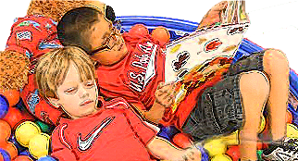
What Is The Difference?
Bright Child | Gifted Learner | Creative Learner
Answers questions | Discusses in detail with much elaboration | Thinks of new entirely different possibilities

Slide 10
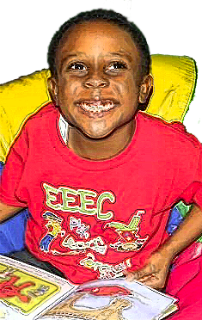
What Is The Difference?
Bright Child | Gifted Learner | Creative Learner
Listens with interest | Expresses strong opinions | Shares conflicting opinions
Yes, but what I would really like to do is…
“What do you really want?
But, what about …

Slide 11
What Is The Difference?
Bright Child | Gifted Learner | Creative Learner
Learns with ease | Already knows material | Wonders about other possibilities
Oh, I know the answer!
Yes, but did you know…
But, what if…

Slide 12
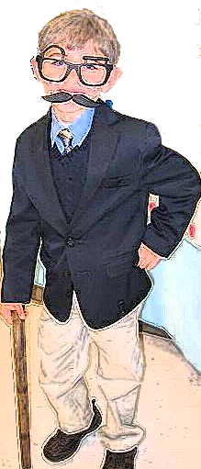
What Is The Difference?
Bright Child | Gifted Learner | Creative Learner
Enjoys and gets along well with peers | Prefers adults | May prefer to be alone or with a creative peer

Slide 13
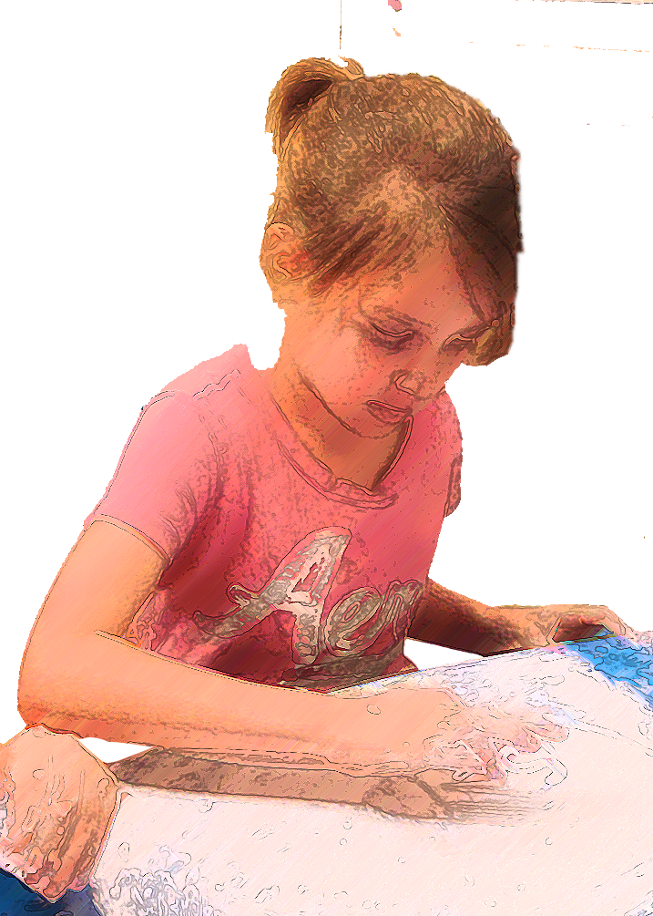
What Is The Difference?
Bright Child | Gifted Learner | Creative Learner
Usually earns good grades in all subjects | May make good grades without effort or they may not be motivated by grades at all | May not be motivated by grades

Slide 14
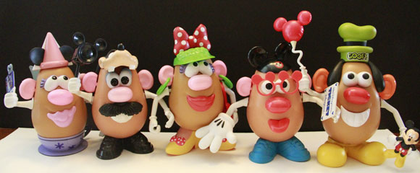
Increasing Depth & Complexity
Purposeful Instruction
Keep doing what works
Example from Alabama COS
Notes:
Two big idea:
You don’t need to reboot or start everything new again from scratch.
Whatever you’re doing to successfully manage you classroom, keep doing it.
Your best way to meet the needs of gifted students is to continue engaging them with purposeful instruction.

Slide 15
Example
With prompting and support, retell familiar stories, including key details. [RL.K.2]
Use a combination of drawing, dictating, and writing to narrate a single event or several loosely linked events, tell about the events in the order in which they occurred, and provide a reaction to what happened. [W.K.3]
Notes:
Two big idea:
You don’t need to reboot or start everything new again from scratch.
Whatever you’re doing to successfully manage you classroom, keep doing it.
Your best way to meet the needs of gifted students is to continue engaging them with purposeful instruction.

Slide 16
Advanced Objectives
Retell a familiar story, changing key details, characters, and sequence of events.
Use a combination of drawing and writing to tell a story that is similar to a familiar story.
Example:
Humpty Dumpty

Slide 17
Adventures Program
Gifted students receive services one day per week in a five hour “Pull Out” Program.
Services usually provided for students in 3rd through 6th grade
Intellectual
Creative
Child Find Activities begin in 2nd Grade
Practical

Slide 18
Identification of Gifted Students
Students may be referred by:
Teacher Referrals
Parent Referrals
Once referred:
Testing conducted by Psychometrist
Collect Work Samples & Products

Slide 19
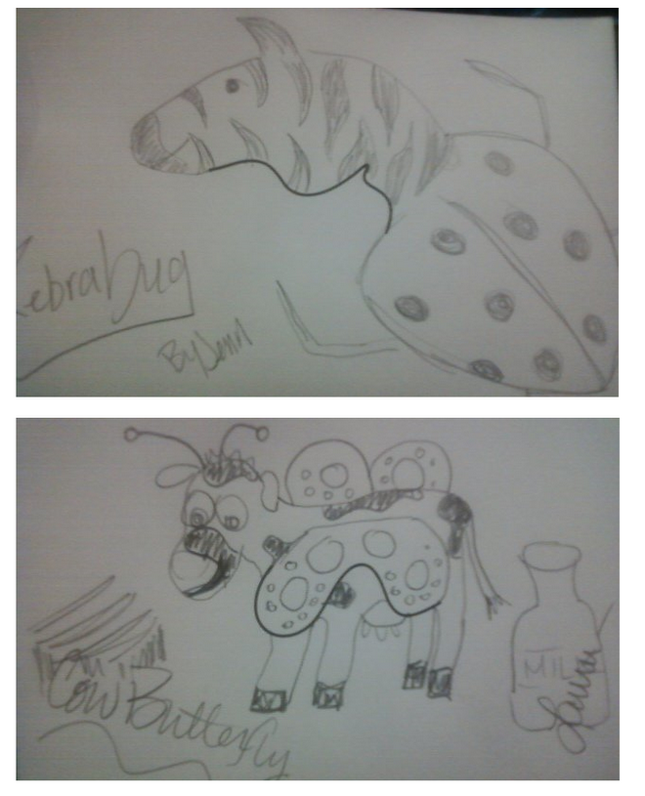
Second Grade Child Find
Teachers and Gifted Education Teachers collaborate to identify students to submit for testing
Creative thinking activities
Collect work samples
Get to know the children

Slide 20
Creative Thinking Activities

Slide 21
Analytical Thinking Activities

Slide 22
Practical and Affective Needs

Slide 23
Needs for Depth and Complexity

Slide 24
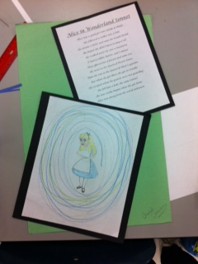
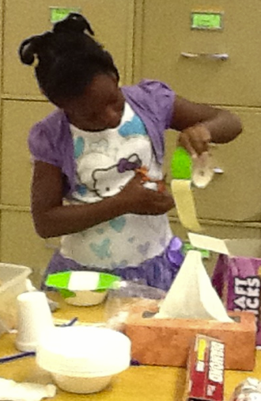
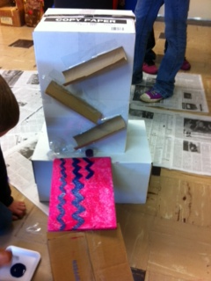
Celebration of the Arts
April 1st
Opportunity for all ABC students to share
Creations
Studies
Ideas
Talents
It's a time for each of them to shine!

Slide 25
References
State of Alabama Gifted Code (290-8-9.12 Gifted)
Kingor, Bertie. High Achiever, Gifted Learner, Creative Thinker
Farrell, Shirley. Traits Aptitudes and Behaviors. ALSDE
More information on our websites:
http://abcthompson.weebly.com
http://thinkdifferentlyinabc.weebly.com/
www.margietyner.net

